Slide 1

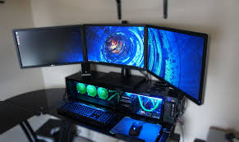


Computer Gaming Programmer
Birkaran Gill

Slide 2



What is my Career
Write codes that will eventually become a playable video game
specialized, allowing them to focus skills and work with a collaborative development process
countless hours, Collaborative skills, physical hazards
result of eyestrain, visual problems, vulnerable to hand ailments - Carpal Tunnel syndrome
everyday teens, youtubers, gaming clans

Slide 3



Career Opportunities
Median Annual Salary (2014) $83,410 yearly
There are many opportunities to become a programmer
Also depends on education

Slide 4


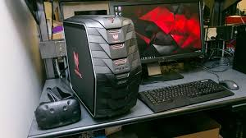

Connections with Technology
Depends on the profile of the programmer
Programs Used: C++, Unity Editor, Unreal Engine 4, Game Maker
Computers used: ABS gaming, acer predator, alienware
Languages: HTML5 and CSS3 are the languages used in the web to give a page structure and visual display elements, respectively.

Slide 5



Program Requirements
Bachelors degree preferred: video game design or computer science
experience: professional portfolio; internships or co-op
minimum Requirement: high school diploma, University level

Slide 6




College Programs
Algonquin college: game development
sheridan college: bachelor (honours) of game design, game development advanced programming

Slide 7
Citations
“What Does a Video Game Programmer Do?” Learn.org -, learn.org/articlesWhat_Does_a_Video_Game_Programmer_Do.html.
Greene, Felicia. “What Are the Working Conditions of a Game Designer?” Woman, woman.thenest.com/working-conditions-game-designer-11137.html.
“The 6 Best Programming Languages for Game Design.” Become a Video Game Designer, 3 Oct. 2017, www.gamedesigning.org/career/programming-languages/.
Study.com, Study.com, study.com/articles/How_to_Become_a_Video_Game_Designer_Education_and_Career_Roadmap.html.
“What to expect from a career as a Computer or Video Game Designer.” Computer - Gaming, www.ontariocolleges.ca/en/programs/computers-and-telecommunications/computer-gaming?q=&page=1.

